Slide 1


Slide 2

IOT-Based Air Quality Index Meter System
By
Huzaifa Shahbaz – 21-CE-009
Aqsa Shah – 21-CE-039
Supervisor: Ma’am Sara Tehsin

Slide 3
Outline:
Introduction
Problem Statement
Objective
Proposed Design
Literature Review
Architecture Diagram
Results
Conclusion
References

Slide 4
Introduction:
Air quality monitoring is vital for health and the environment.
IoT systems measure pollutants like PM2.5, PM10, CO, and NO2.
Real-time data improves our understanding of air quality.
AQI systems raise awareness and inform policies for swift responses.

Slide 5
Problem Statement:
The decline in air quality, driven by urbanization and industrialization, poses serious health risks and environmental challenges. Current monitoring systems have lengthy detection ranges, preventing accurate local readings of pollutants. This limitation hinders timely interventions and effective decision-making.

Slide 6
Objective:
The objective of this project is:
To Identify key pollutants
To Analyse their impact on health and the environment
To Enable real-time monitoring for timely interventions
Stakeholder Impact:
Industries
The public
Environmental agencies
Local governments
Health Management

Slide 7
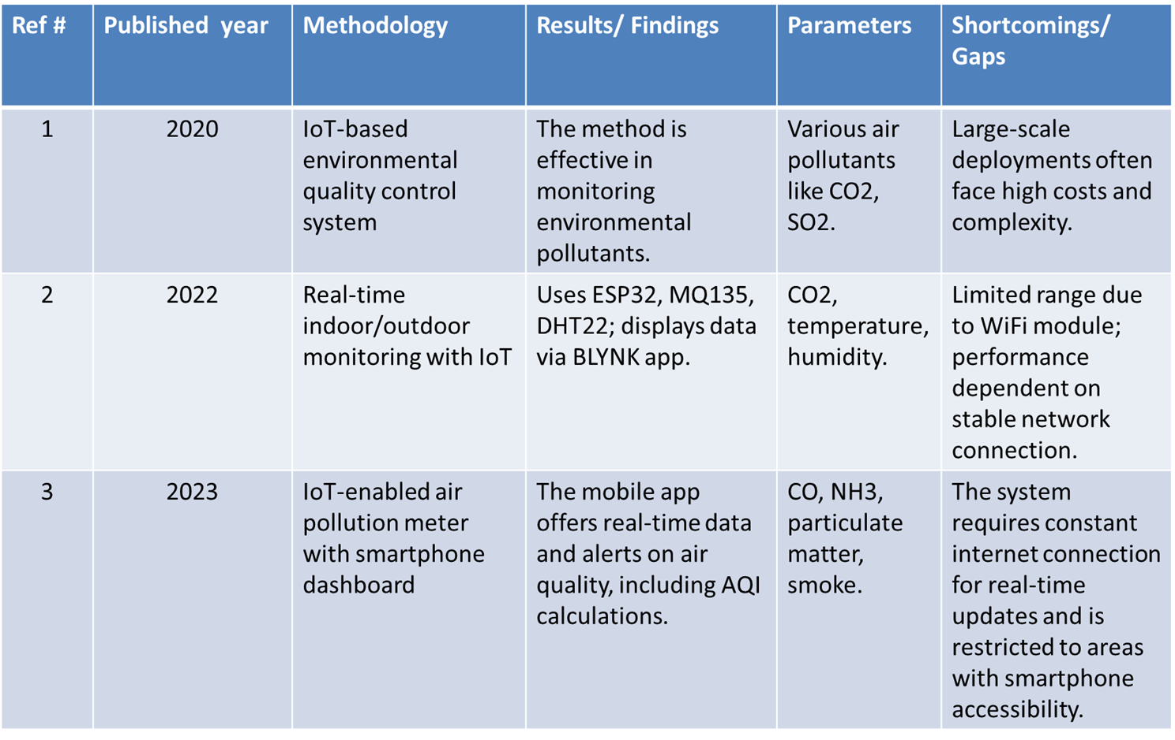
Literature Review:

Slide 8

Comparison Of Systems:
Functionality | Proposed System | Existing System
 | AQIM | System 1 (2020) | System 2 (2022) | System 3 (2023)
Real-time monitoring | Yes | Yes | No | Yes
Data Accuracy | High | Medium | Low | Medium
Ease of use | Yes | No | Yes | No
Security | Yes | No | Yes | No
Alerts and Notification | Multiple Sensors | Single Sensor | Single Sensor | Multiple Sensors
Historical Data Analysis | Yes | No | No | Yes
Cost Efficiency |  | High | Medium | Low
Scalability | High | Low | Medium | High
Maintenance Requirements | Low | High | Medium | Low

Slide 9

PROPOSED DESIGN/METHOGOLDY:
Abstract Design:
The IoT-based AQI Meter uses advanced real-time air quality monitoring sensors, sending data wirelessly to a cloud platform for reliable analysis.
Component Level Design:
The project involves creating sensor modules, microcontrollers, and communication interfaces for effective data acquisition, processing, and transmission.
SRS Overview:
The Software Requirements Specification (SRS) outlines the essential functional and non-functional requirements, ensuring accurate pollutant measurement and real-time user alerts.
9

Slide 10
Architecture Diagrams:
ESP32
ESP8266
Arduino Uno
PM2.5 & PM10 Sensors
MQ-Gas Sensors (MQ-05 &MQ-135)
Weatherproof Housing
Android Studio & Firebase
Blynk App

Slide 11
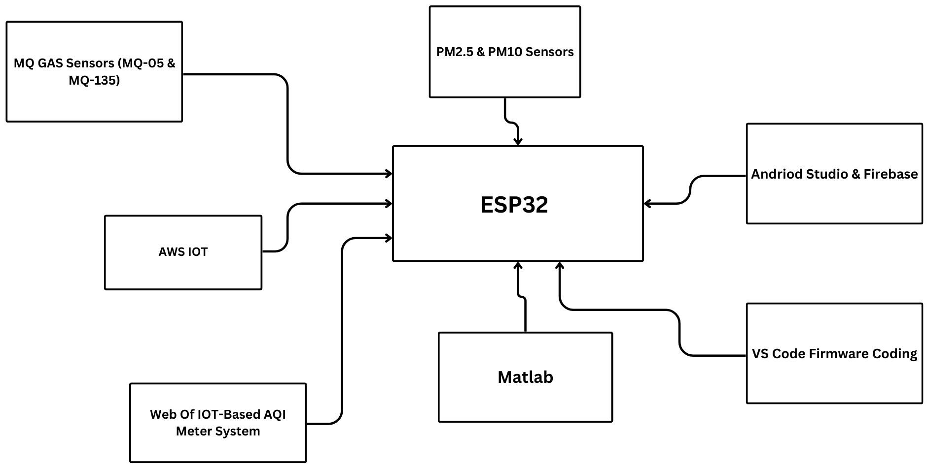
ESP32 Diagram:

Slide 12

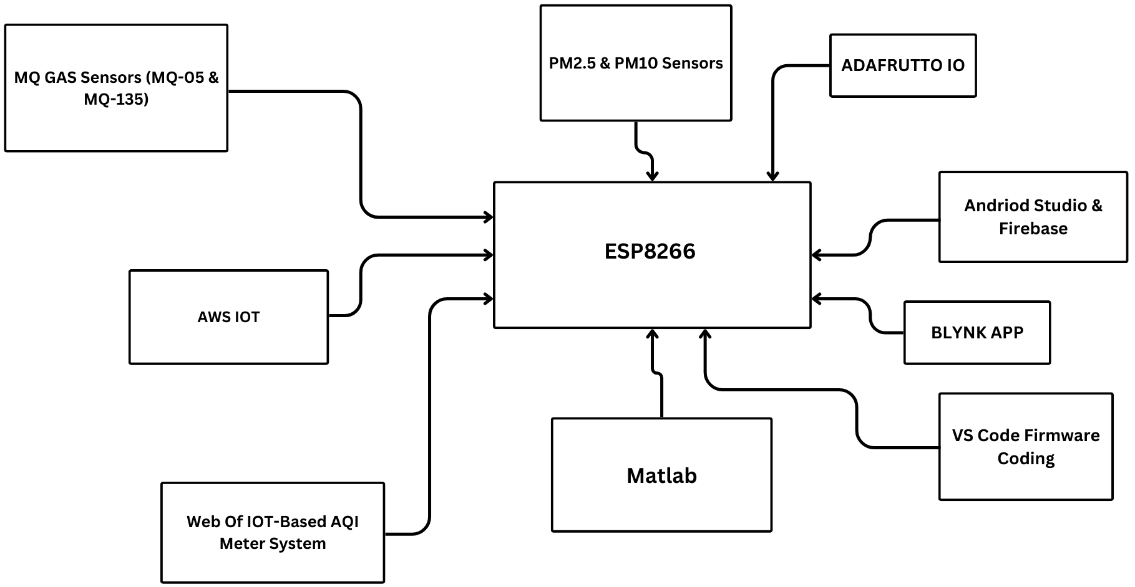
ESP8266 Diagram:

Slide 13
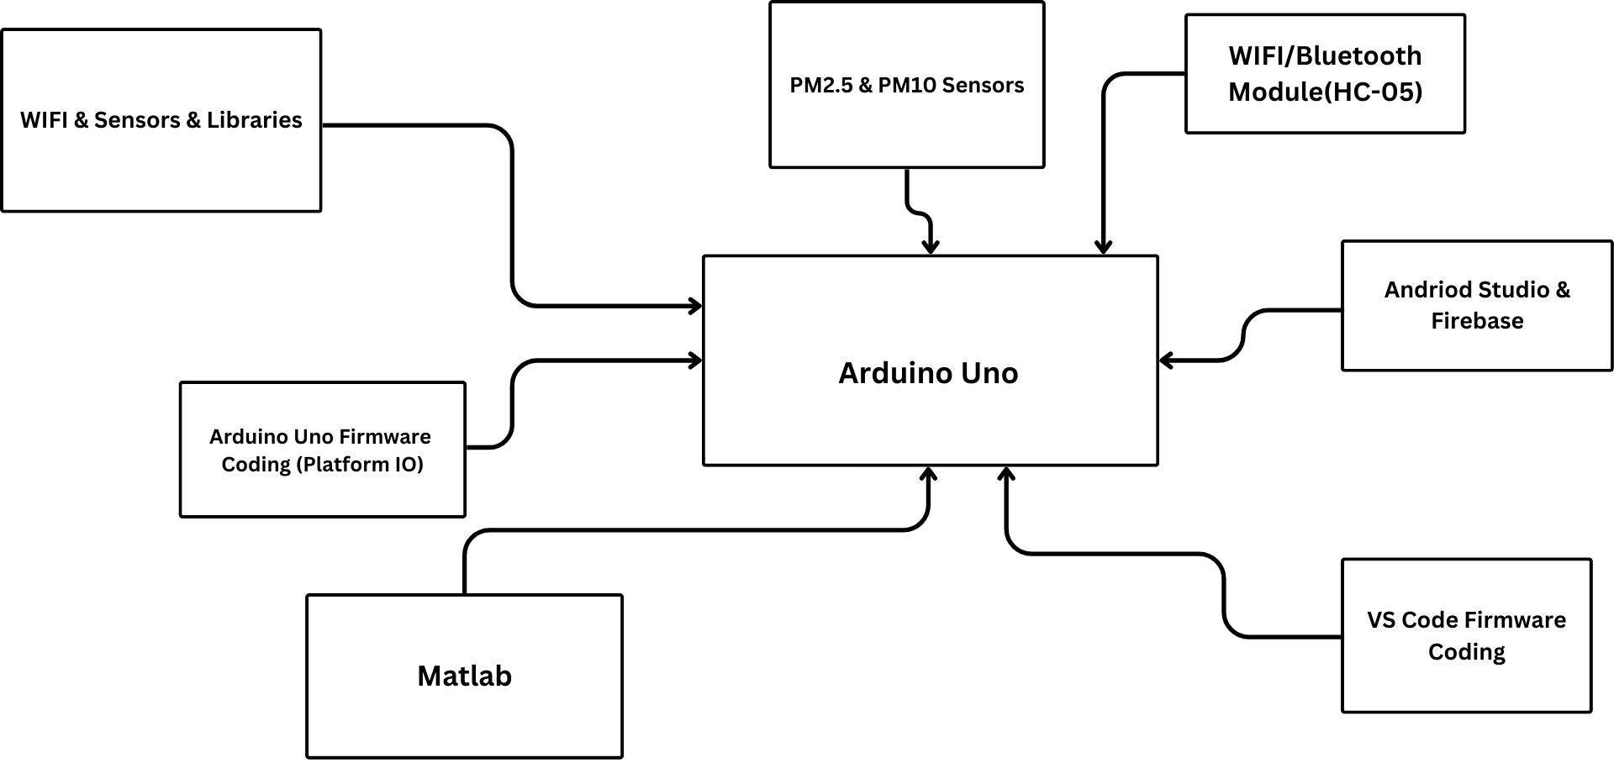
Arduino Uno Diagram:

Slide 14
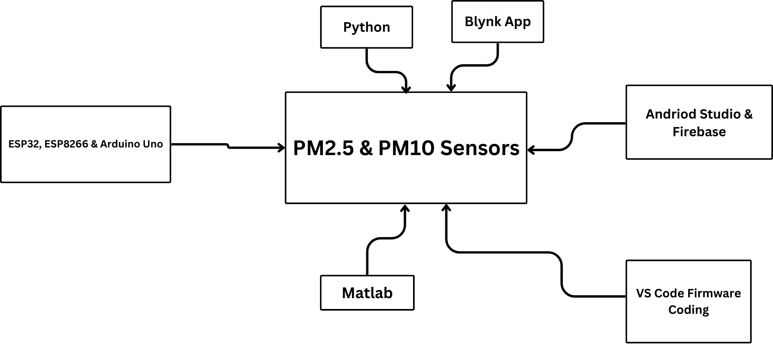
PM Sensors Diagram:

Slide 15
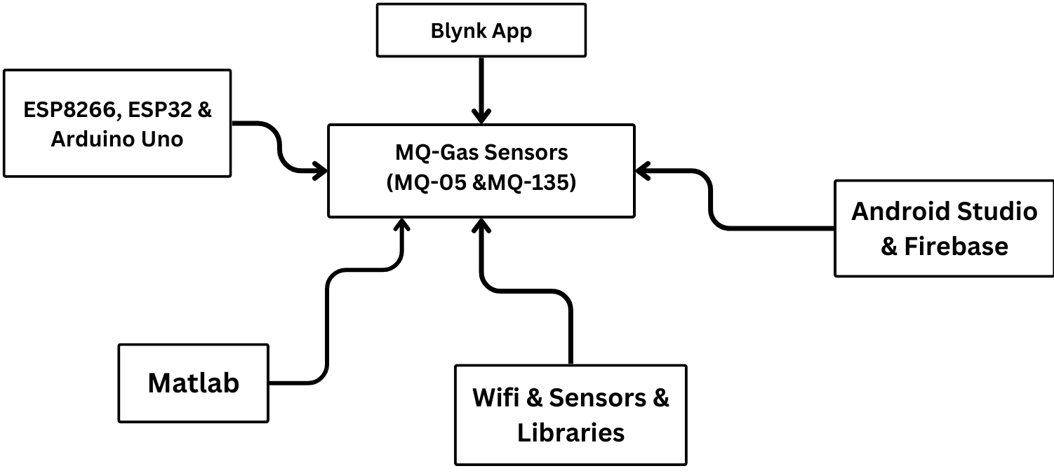
MQ Sensors Diagram:

Slide 16
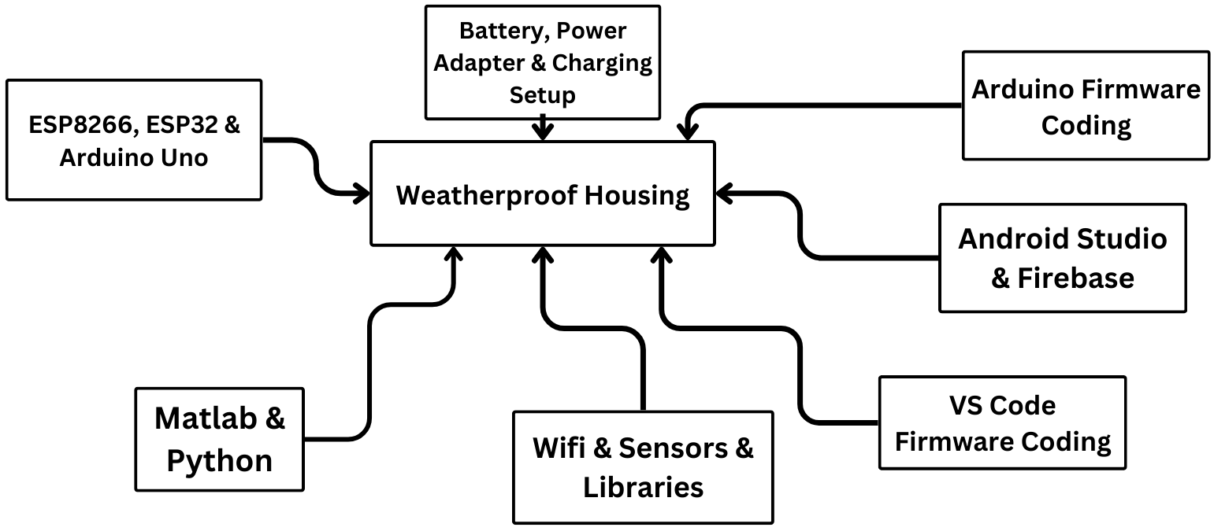
Weatherproof Housing Diagram:

Slide 17
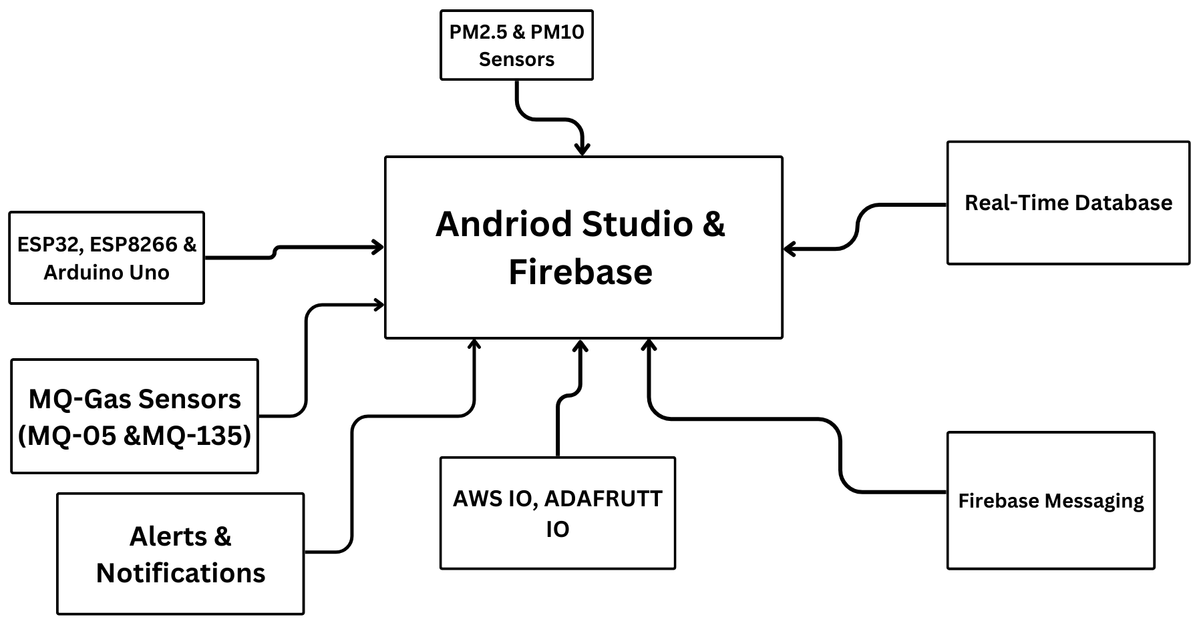
Android Studio & Firebase Diagram:

Slide 18
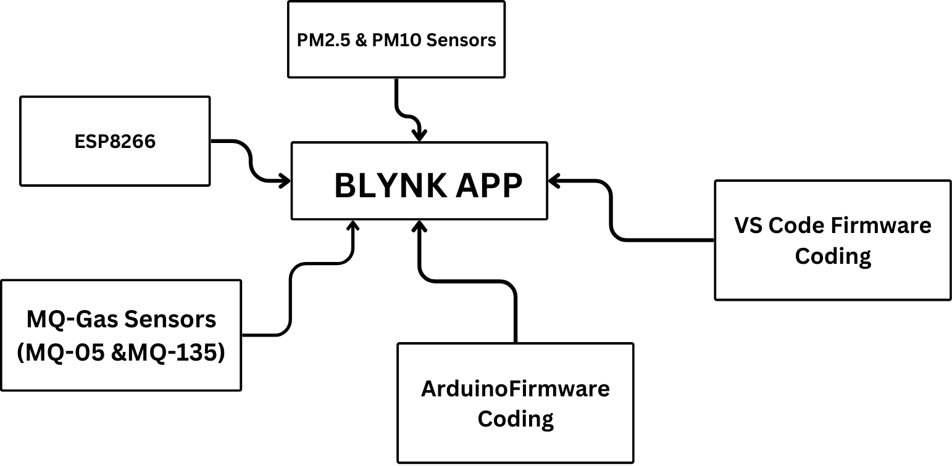
Blynk App Diagram:

Slide 19

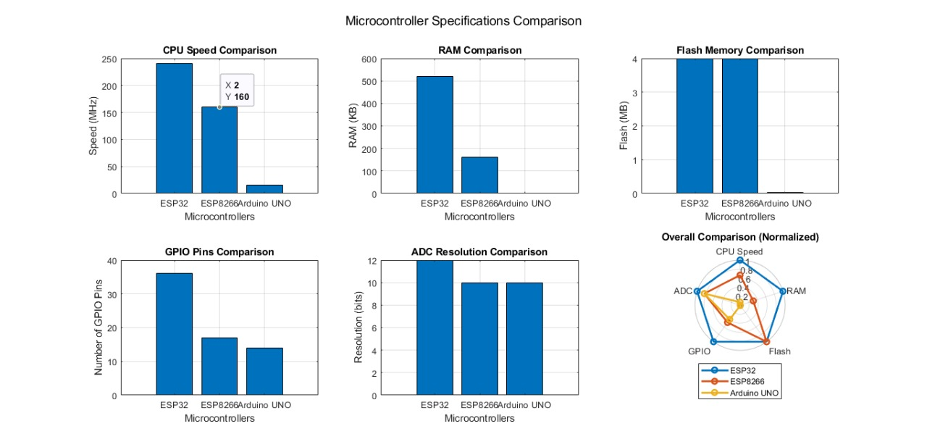
Results:

Slide 20

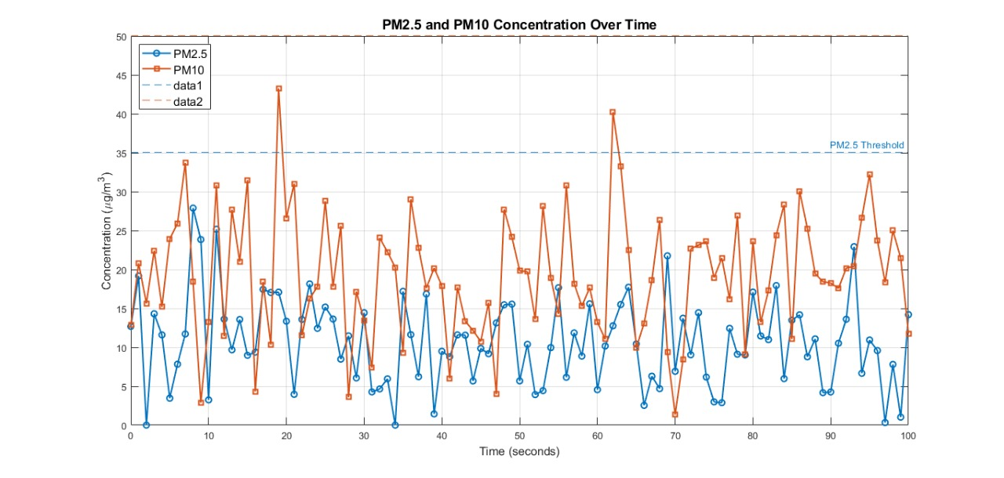
Results:

Slide 21
References:
1:Dineshkumar, T., V. Suresh Babu, Pachaivannan Partheeban, and R. Puviarasi. "Air Quality Monitoring System Based on IoT." *Journal of Physics: Conference Series* 1964, no. 6 (2021): 062081. https://doi.org/10.1088/1742-6596/1964/6/062081.
2: Hemalatha, M., R. Arunprasath, J. Shalini Priya, A. M. Shivashankari, K. Rajkumar, and R. Jeyashri. "An IoT Enabled Air Pollution Meter with Digital Dashboard on Smartphone." In 2023 Intelligent Computing and Control for Engineering and Business Systems (ICCEBS), IEEE, 2023. https://doi.org/10.1109/ICCEBS58601.2023.10448896.
3: Yusof, Khairul Huda, M. Abdulrazaq, Fadhilah Aman, M. N. Mohammed, Amirul Asyraf, Ahmad Sukri Ahmad, and Mohamad Syahrul Zahwan Mohd Zabidi. "Design and Development of Real Time Indoor and Outdoor Air Quality Monitoring System Based on IoT Technology." In 2022 IEEE 18th International Colloquium on Signal Processing & Applications (CSPA 2022), Selangor, Malaysia, May 12, 2022. IEEE. https://doi.org/10.1109/CSPA55076.2022.9781937.
4: Yusof, K. H., Abdulrazaq, M., Aman, F., Mohammed, M. N., Asyraf, A., Sukri, A., Zabidi, M. S. M., & Alayham, A. R. (2022). Design and Development of Real Time Indoor and Outdoor Air Quality Monitoring System Based on IoT Technology. 2022 IEEE 18th International Colloquium on Signal Processing & Applications (CSPA 2022), 12 May 2022, Selangor, Malaysia.
https://ieeexplore.ieee.org/document/9781937

Slide 22
References:
5: IoT Based Air Quality Monitoring System Using Arduino Shazia Afroze 1 , Md. Istiak Hossain Paran 2 , Stamford University Bangladesh (SUB) 2,3Student, Dept. of Electrical & Electronic Engineering, Stamford University Bangladesh (SUB). https://www.ijfmr.com/papers/2023/2/2260.pdf
6: IoT Based: Air Quality Index and Traffic Volume Correlation Omar Alruwaili; Ivica Kostanic; Ali Al-Sabbagh; Hamad Almohamedh. https://ieeexplore.ieee.org/document/9298176/references#references
7: IoT-based_air_quality_monitoring_systems_for_smart Danny Múnera Diana P. Tobon V.
Johnny Aguirre Natalia Gaviria. https://www.researchgate.net/publication/350823548_IoT-based_air_quality_monitoring_systems_for_smart_cities_A_systematic_mapping_study
8: IoT-based_AQI_Estimation_using_Image_Processing_and_Learning_Methods Nitin Nilesh; Ishan Patwardhan; Jayati Narang; Sachin Chaudhari. https://ieeexplore.ieee.org/document/10152272
9: IoT Based Air Quality Index (AQI) Monitoring with ESP8266 & Air Quality Sensor || Pollution in PPM. https://www.youtube.com/watch?v=Ub1ciur95Nk

Slide 23
Thank You

